Slide 1
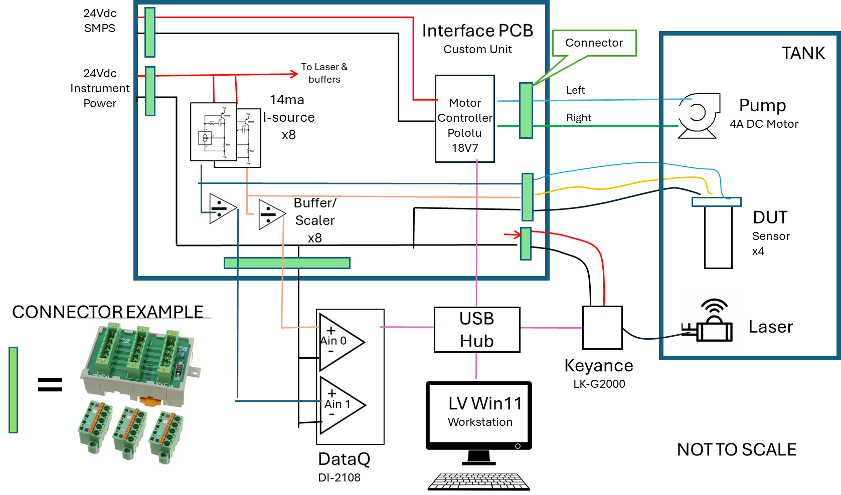
Hardware and Interface PCB block diagram

Slide 2
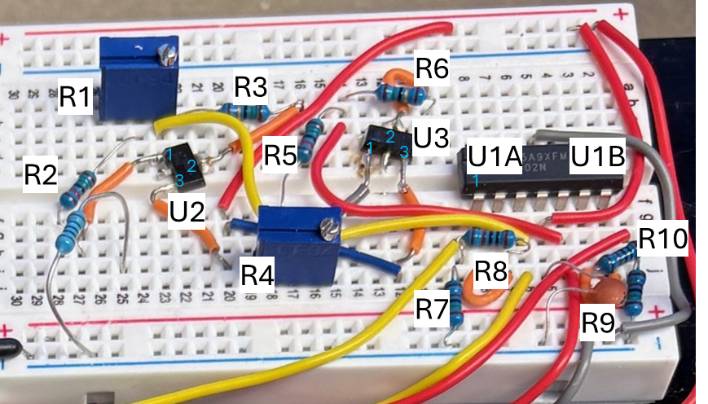
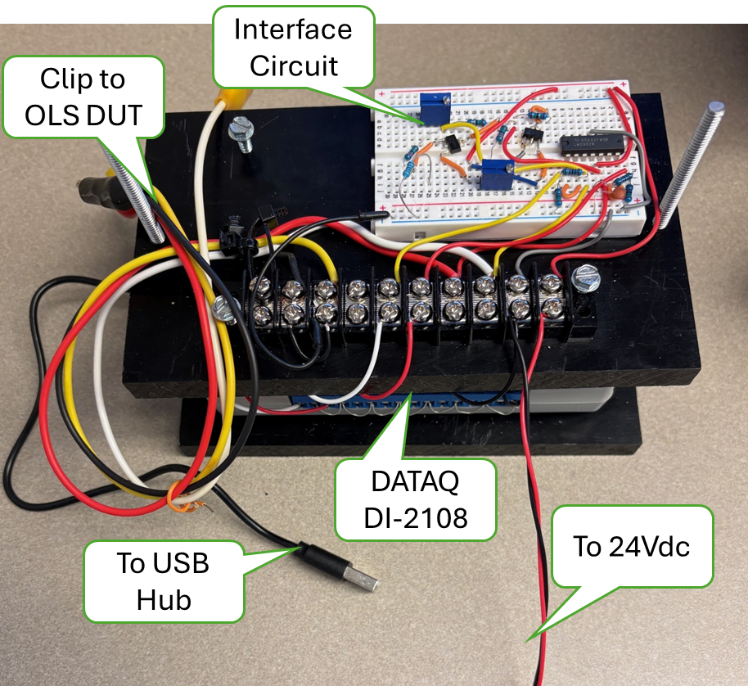
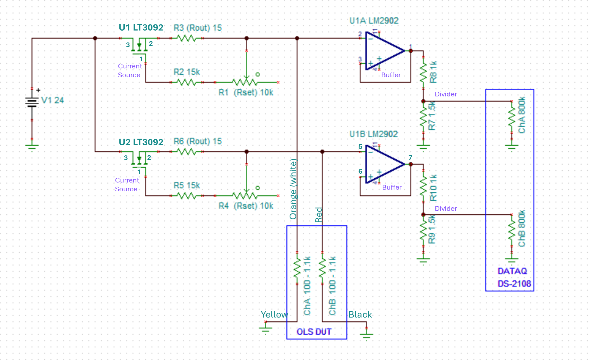
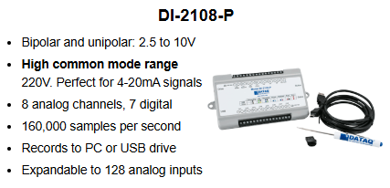
HW and Interface PCB Prototype Schematic and Assy Diagrams
Motor Controller Not Shown
DC Accuracy +/-5mV @10V

Slide 3
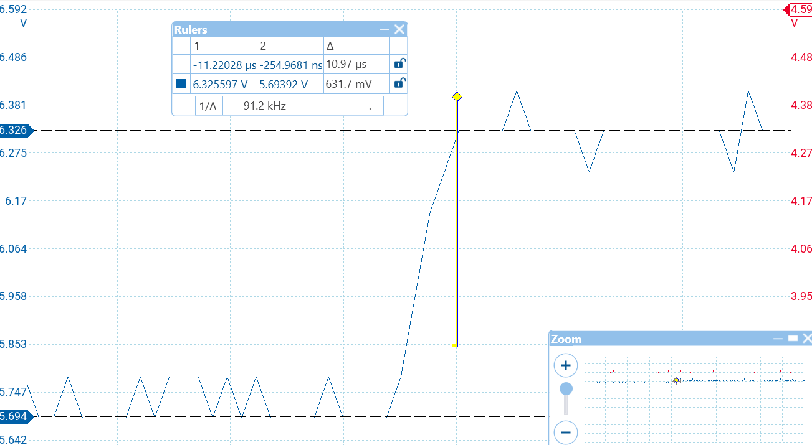
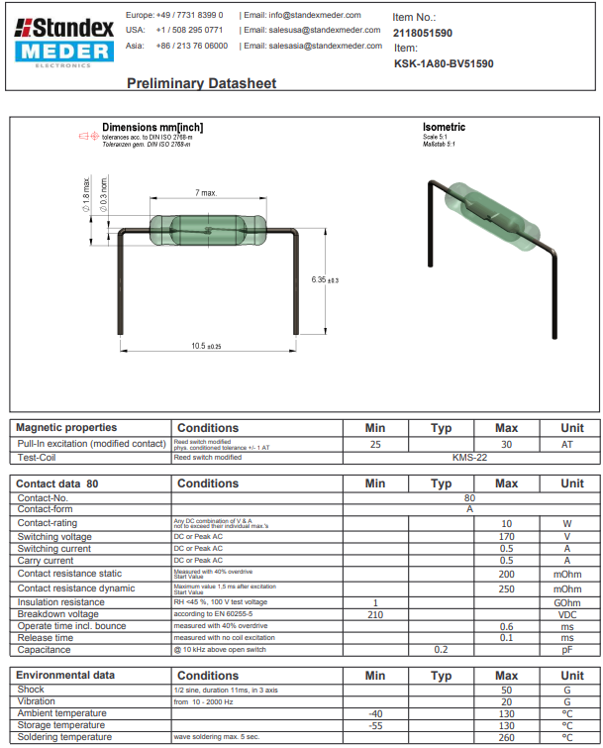
Reed Switch, open->close step response

Slide 4
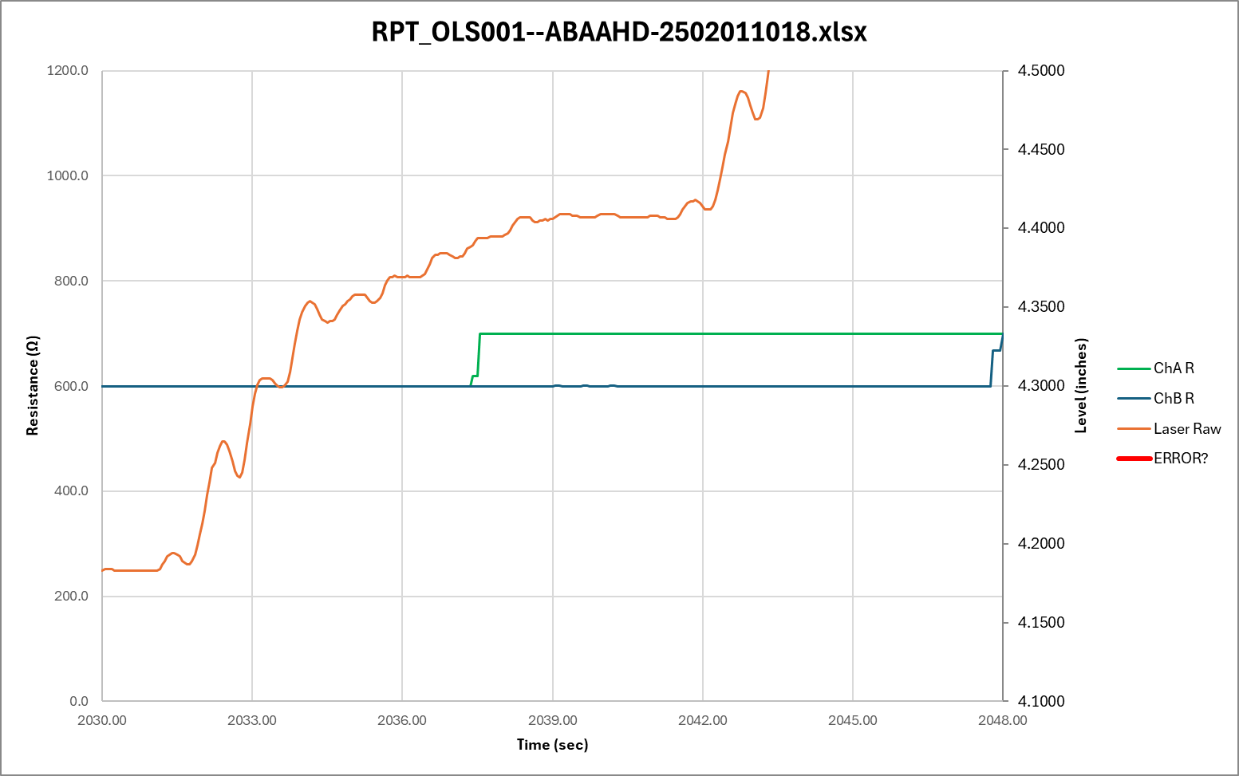
Tank Level step response to 3-speed servo motor control
100%
30%
7%
Waiting

Slide 5
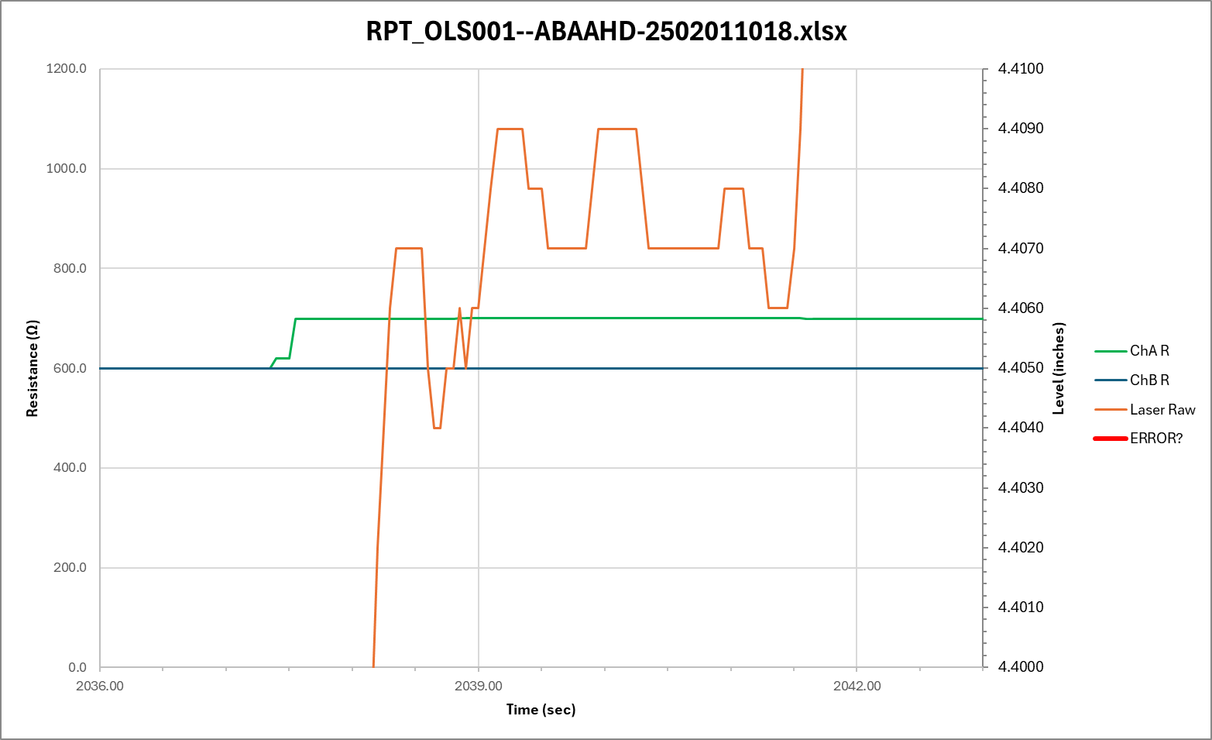
Tank Level step response to 3-speed servo motor control
Zoomed into 3sec wait period
TP Uncertainty

Slide 6
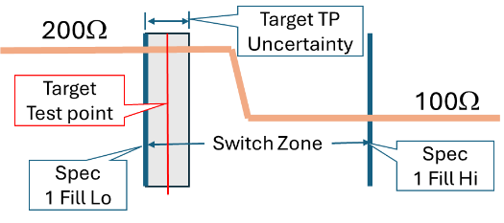
Where to measure resistance to determine “has switched” PASS/FAIL
Full
Empty
LEVEL
The Target Test Point Level (TP) will be set to ½ the level measurement uncertainty after 3 second settling time, prior to the specified upper bound of the Switch Zone.
REQUIREMENT: The Target Test Point uncertainty shall not exceed ???”.
To be defined

Slide 7
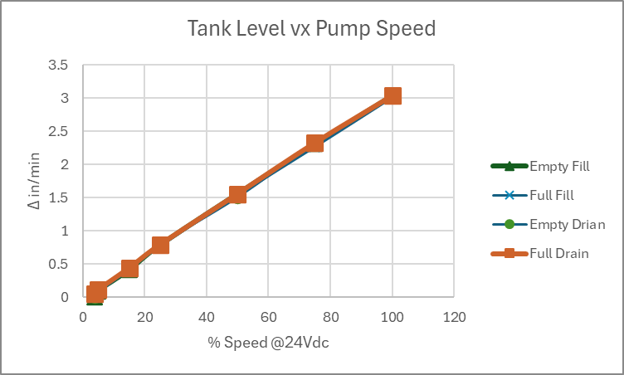
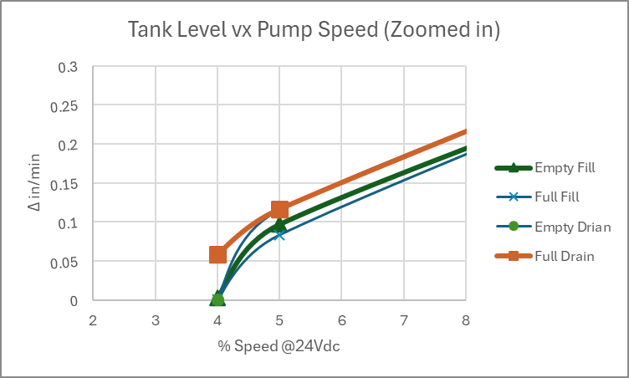
Tank Level Response at various motor speeds
Using the Pololu MC18V7 PWM motor controller with Vs set to 24Vdc, The Δ Level was measure for 30 seconds at various percent of max speed (100% duty cycle) for both FILL and DRAIN at near EMPTY and near FULL.
The response has a minor shift at each case but is basically linear down to about 5% resulting in fill rate of about 0.1”/min where the control becomes unstable by 4% as shown in the ‘Zoomed In Plot.
Without doing an extensive fluid analysis, this response is assumed to be adequate for the MLOI application.
Data from mloi:\PM_Folder\_3 Develop\Design Calculations.xlsx sheet Tank. 3/4/2025 R. Ales

Slide 8
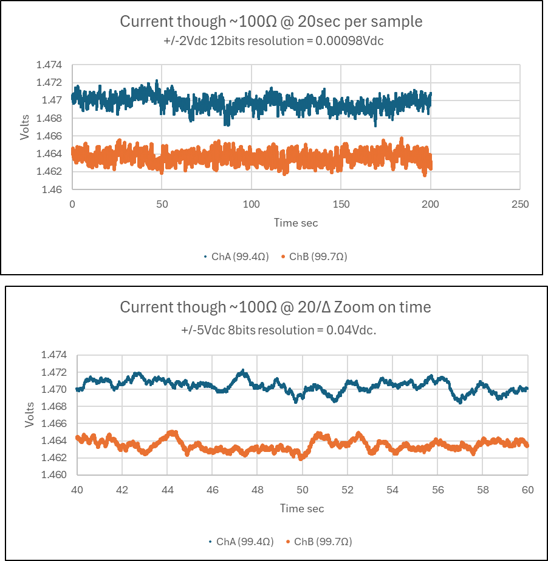
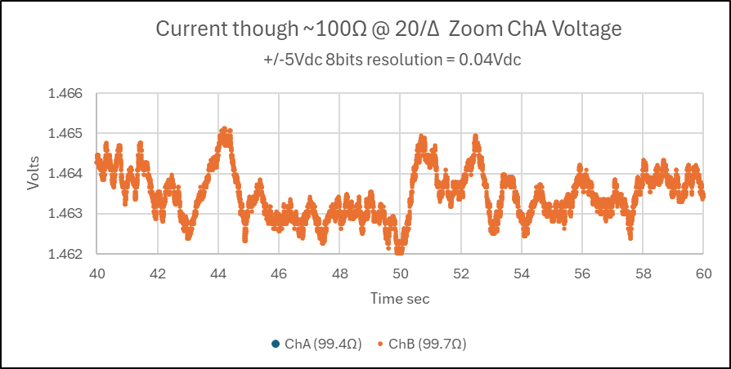
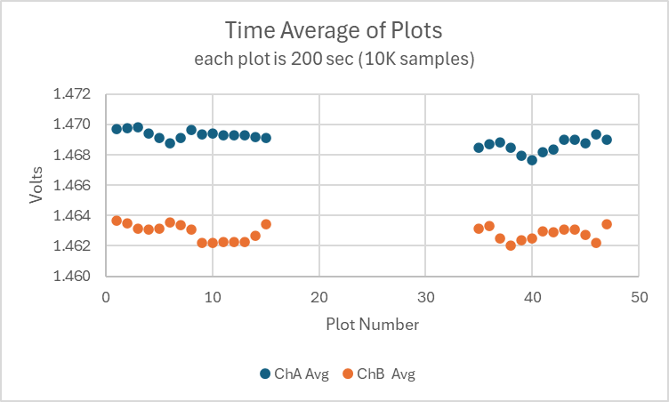
Breadboard LT3092 Current Source Drift over 15 hours
One Plot (marker)

Slide 9
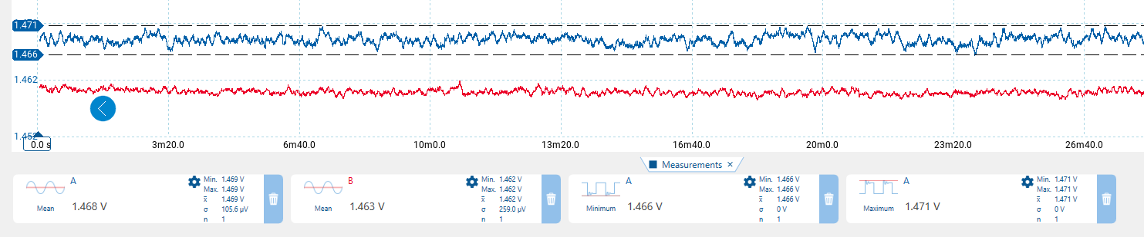
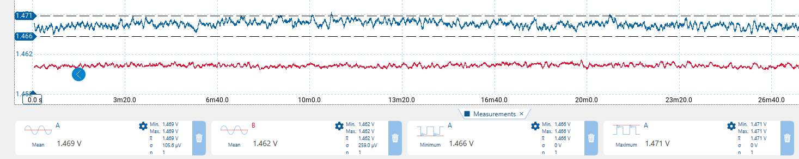
Current source stability over 15 hrs, Start and End trace, 2000 seconds each trace
Time 0 -26min ChA Blue, ChB Red
Mean 1.468V (1.477ma) 1.463V (14.67ma)
Time 14h26min – 15hrs ChA Blue, ChB Red
Mean 1.469V (14.78ma) 1.462V (14.66ma)

Slide 10

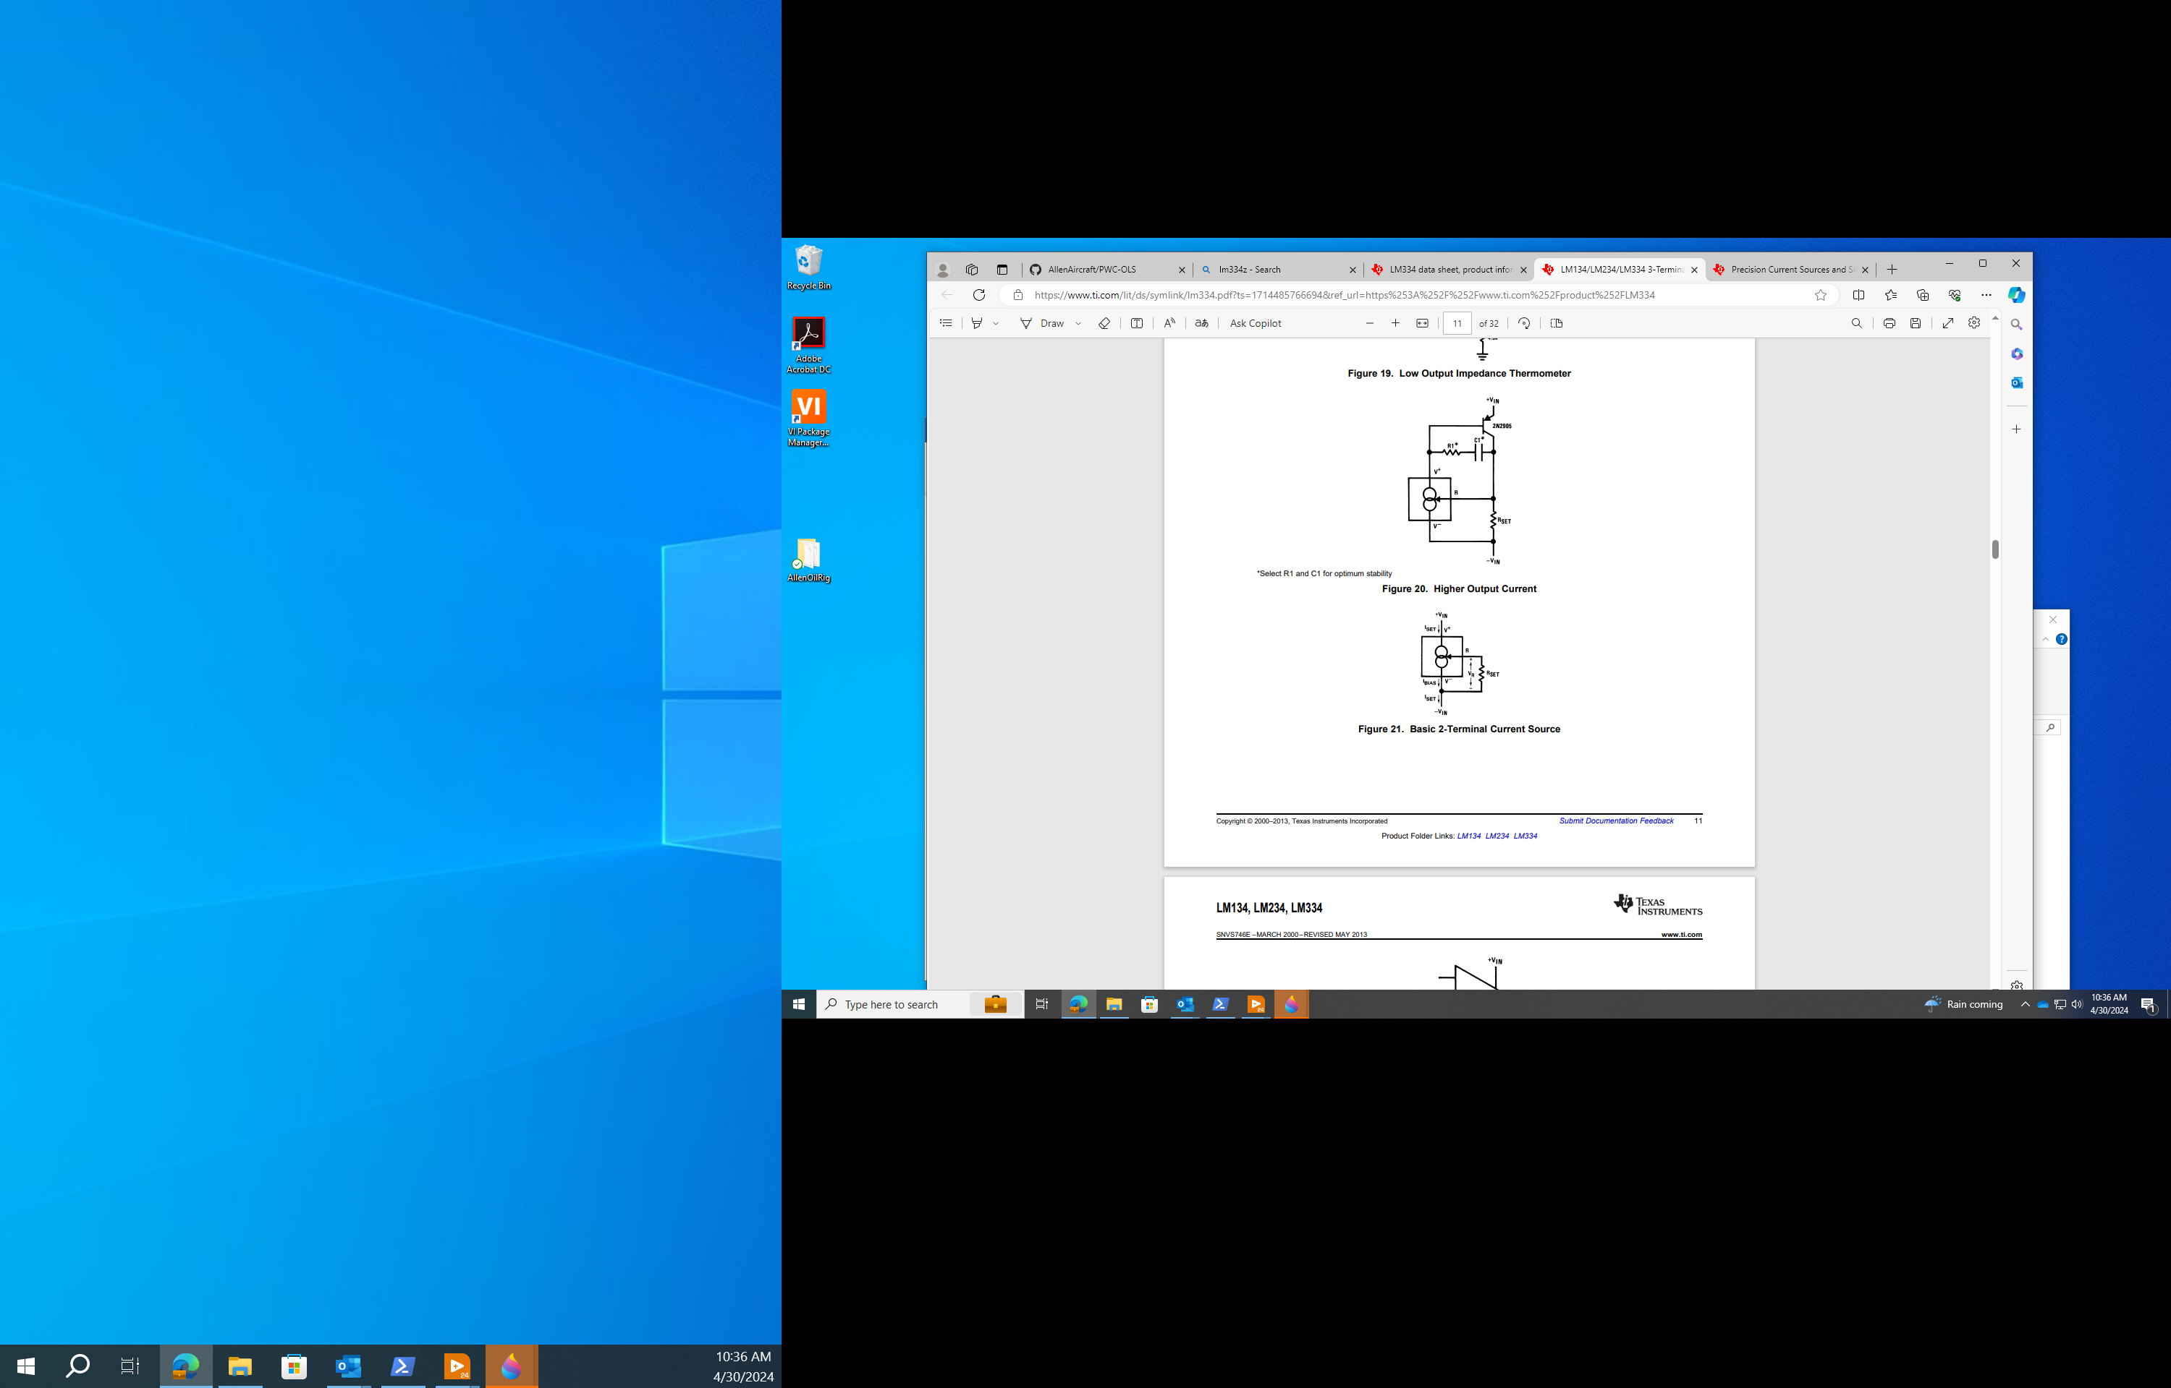


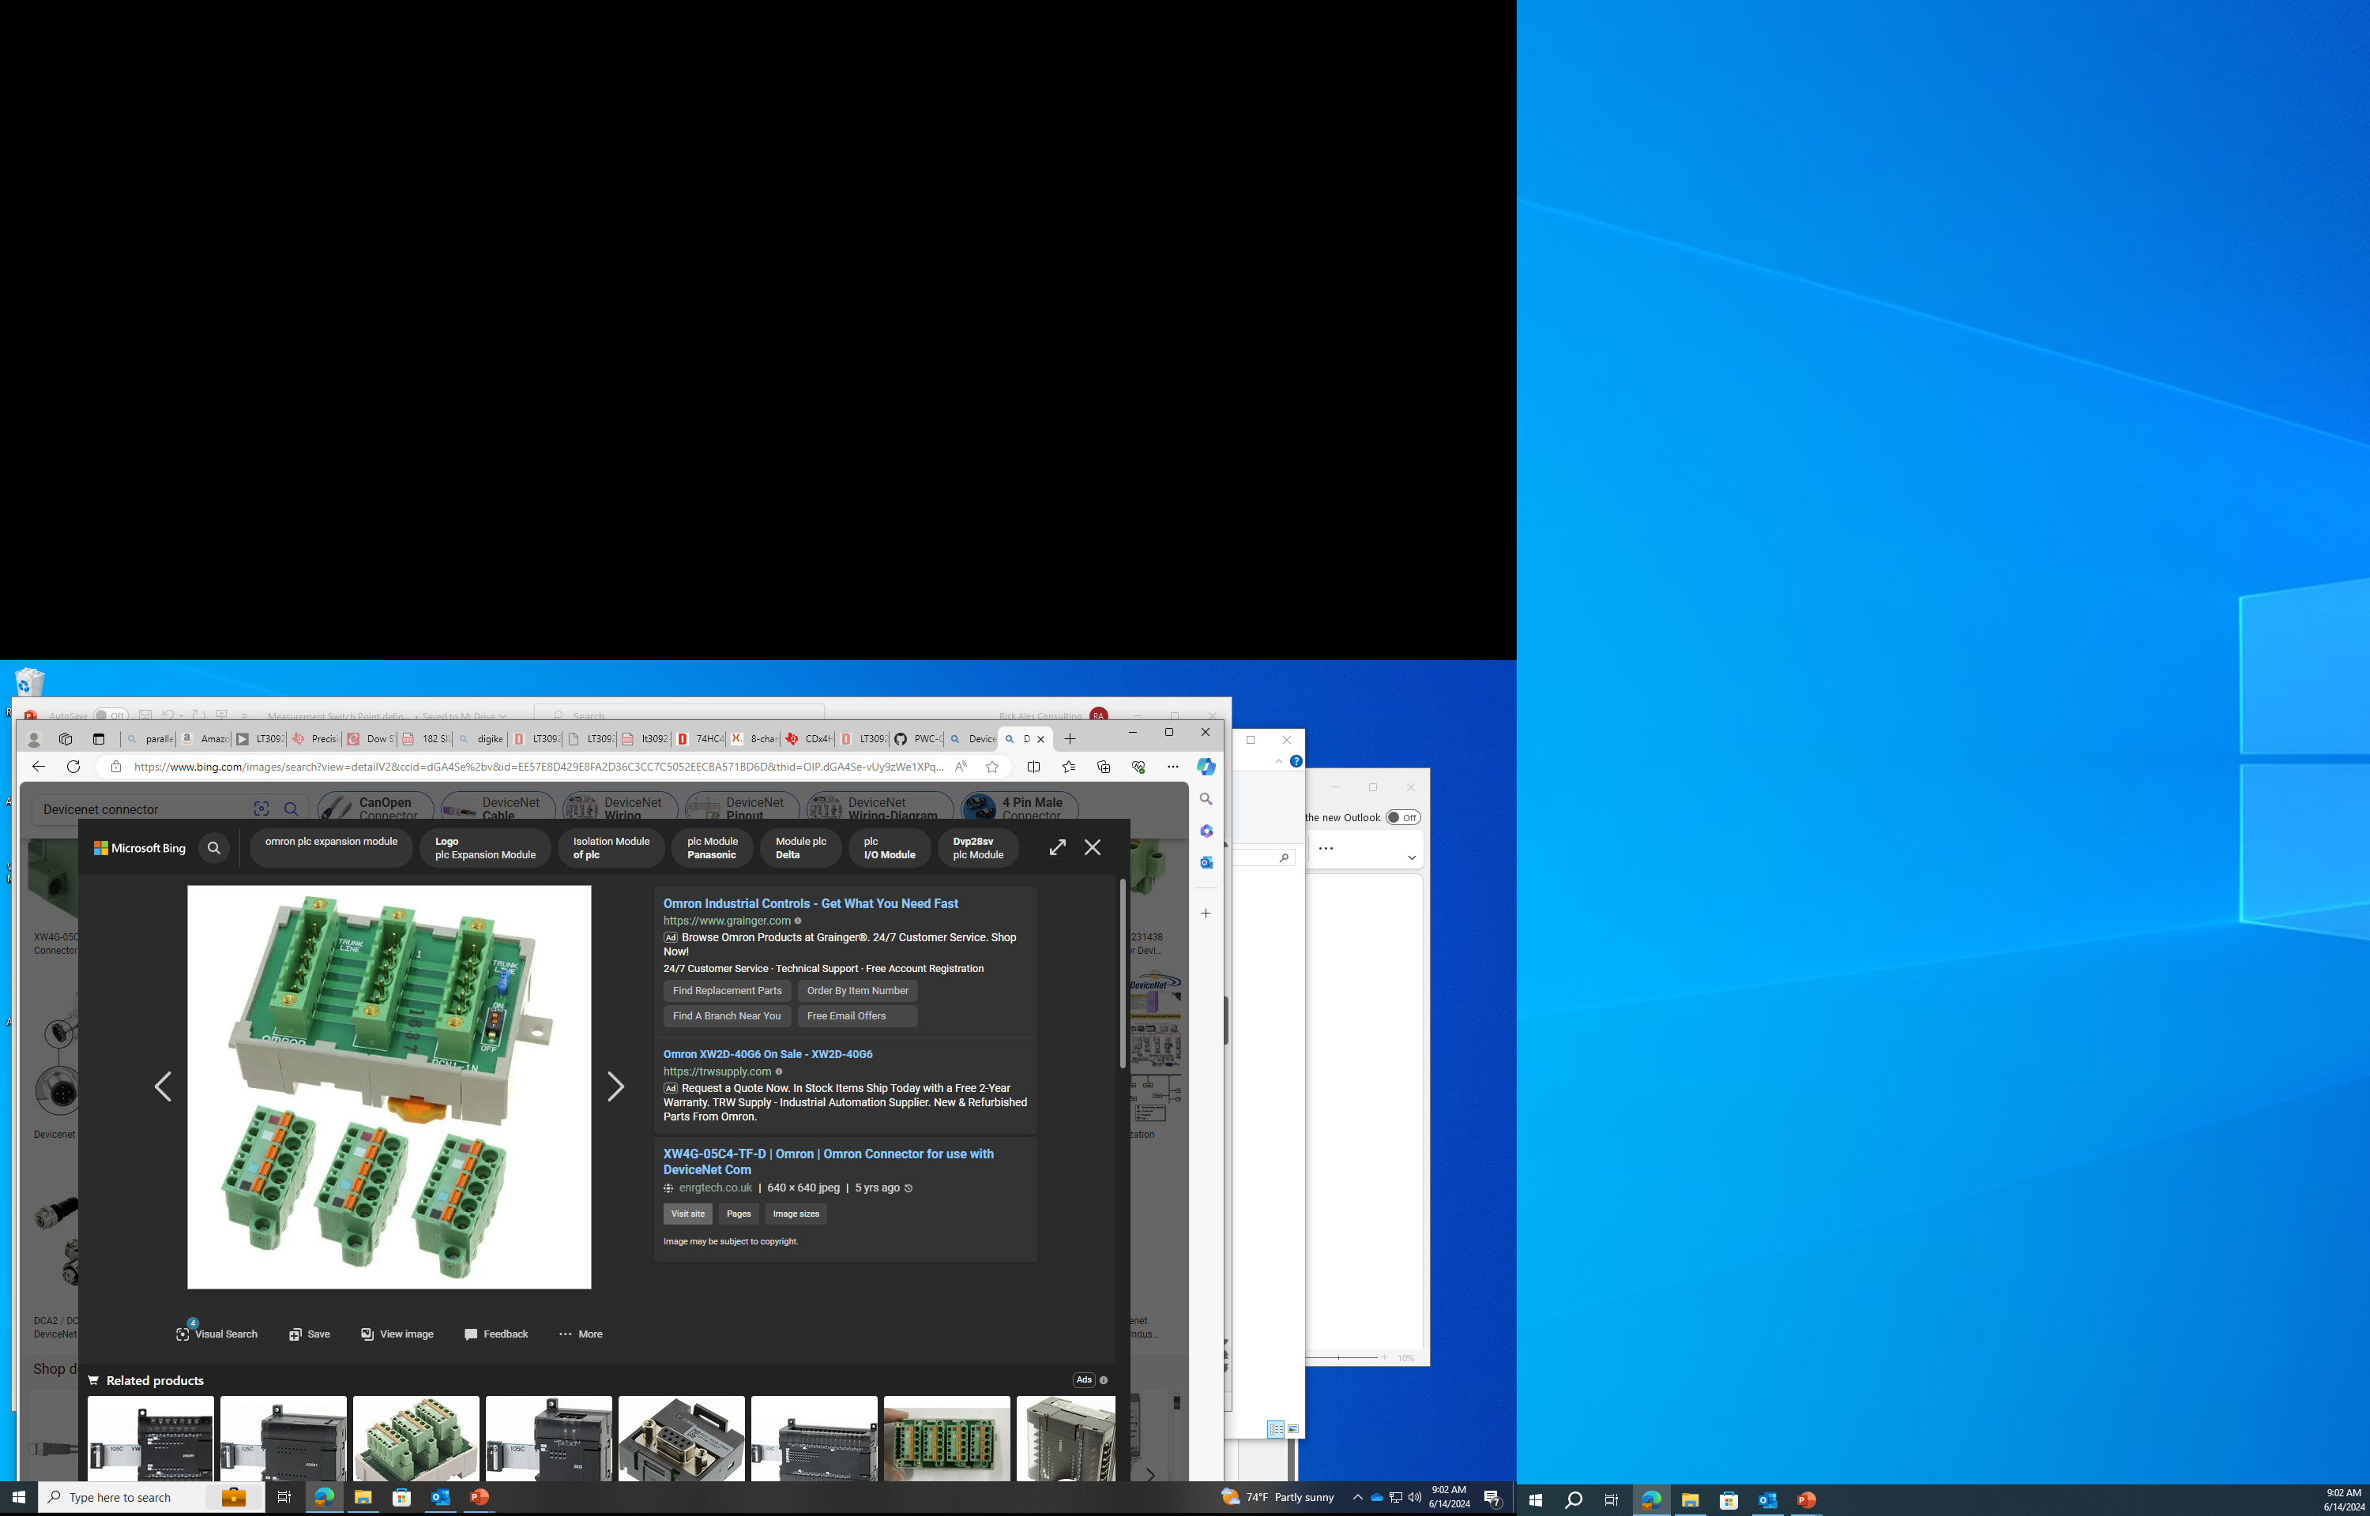
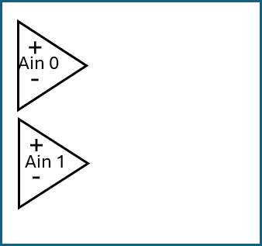

24Vdc
SMPS
24Vdc
Instrument
Power
Interface PCB
Custom Unit
Connector
TANK
To Laser & buffers
14ma
I-source
x8
Left
Right
Pump
4A DC Motor
Motor
Controller
Pololu
18V7
Buffer/
Scaler
x8
DUT
Sensor
x4
CONNECTOR EXAMPLE
USB Hub
Laser
=
Keyance
LK-G2000
LV Win11
Workstation
DataQ
DI-2108
NOT TO SCALE

Slide 11
24Vdc
SMPS
24Vdc
Instrument
Power
Interface PCB
Custom Unit
Connector
Left
Right
Motor
Controller
Pololu
18V7
14ma
I-source
x8
Buffer/
Scaler
x8
Pump
4A DC Motor
+5Vdc
USB Hub
Laser
Keyance
LG-K
DUT
Sensor
x4
LV Win11
Workstation
DataQ
DI-2108

Slide 12
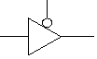
Tri-state
Buffer
Motor
Controller
x4
On/Off
Fwd/Rev
Left
Right
+5Vdc
Do-6
-
+
Ain 0
Do-5
-
+
Do-4
Ain 1
DUT
Sensor
x4
DataQ
DI-2108

Slide 13
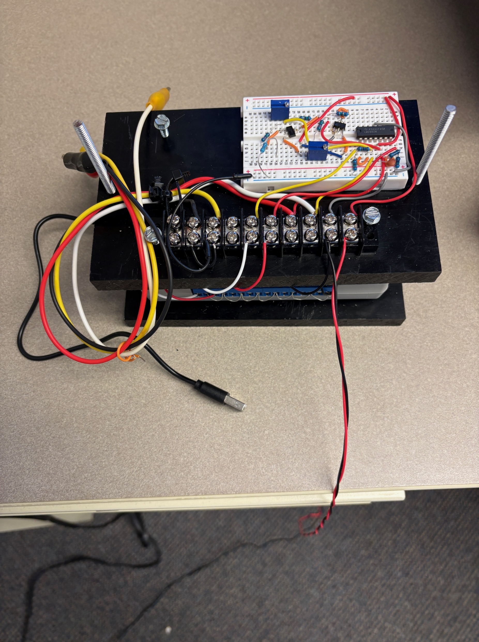
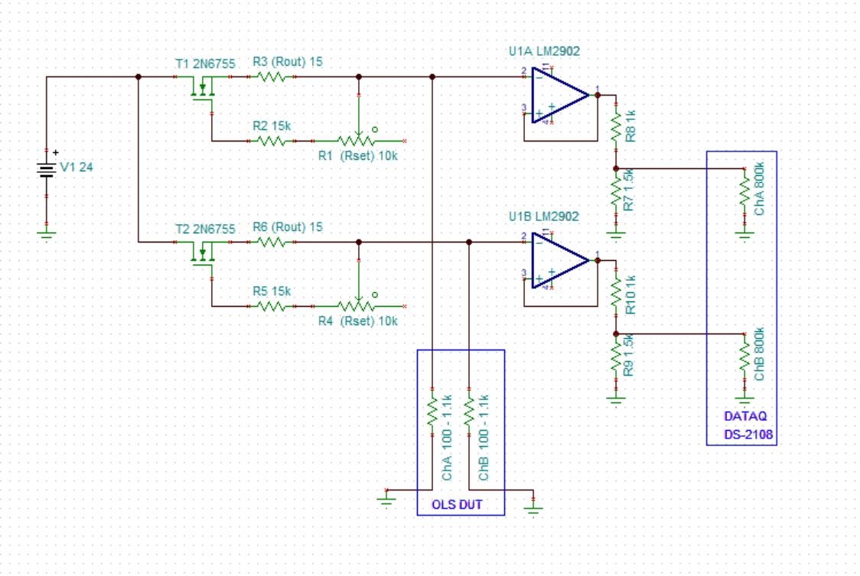

Interface
Circuit
Clip to
OLS DUT
DATAQ
DI-2108
To 24Vdc
To USB Hub
R6
R1
R3
R5
1
2
U3
R2
1
2
3
U1A
U1B
3
1
U2
R10
R4
R8
R7
R9

Slide 14
Interface
Circuit
Clip to
OLS DUT
DATAQ
DI-2108
To 24Vdc
100Ω Ref Resistor
R6
R1
R3
1KΩ Ref Resistor
R5
1
2
U3
R2
1
2
3
U1A
U1B
3
1
U2
R10
R4
R8
R7
R9

Slide 15
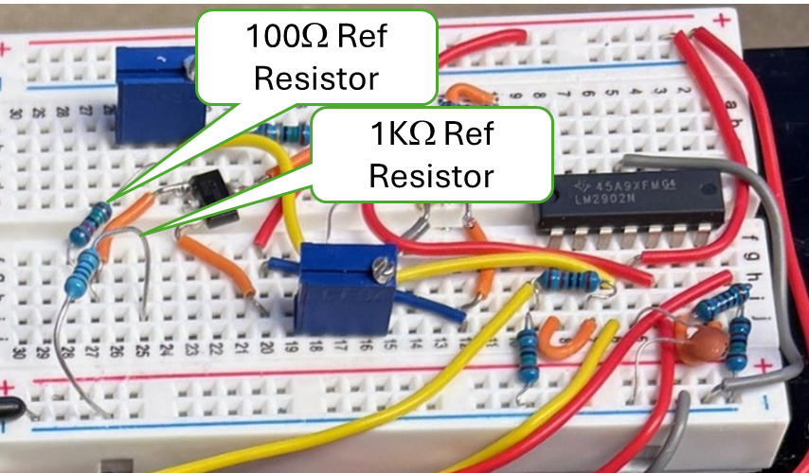
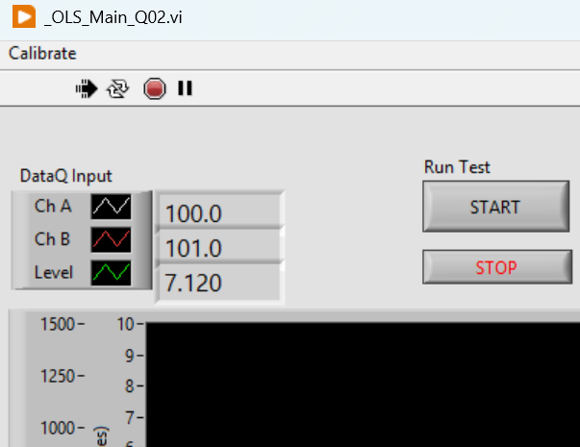
Read App
Resistances Here

Slide 16
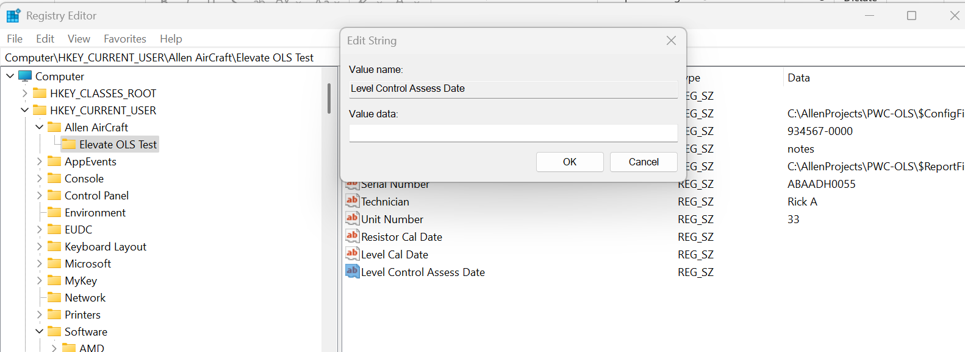
Enter date here
Navigate to this Key
Edit this Value

Slide 17
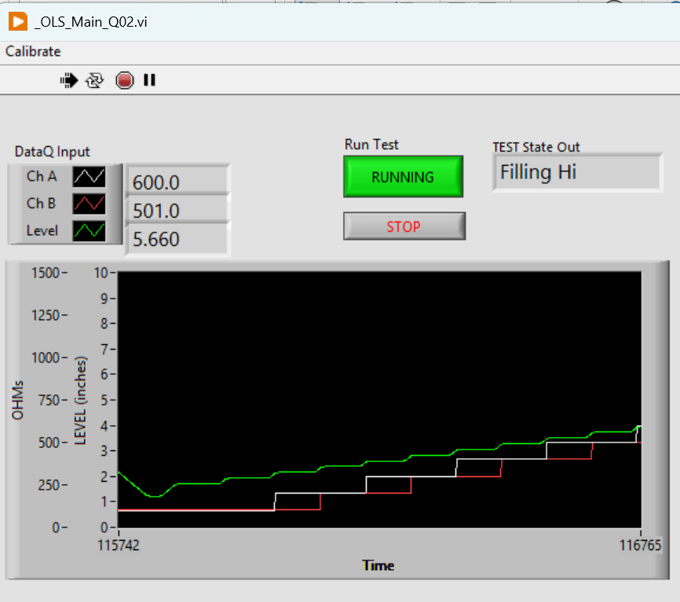
System State and Mode indicator
Click to START or END the automatic Test protocol
STOPS and Exit the application
GREEN Level
WHITE ChA
RED ChB

Slide 18
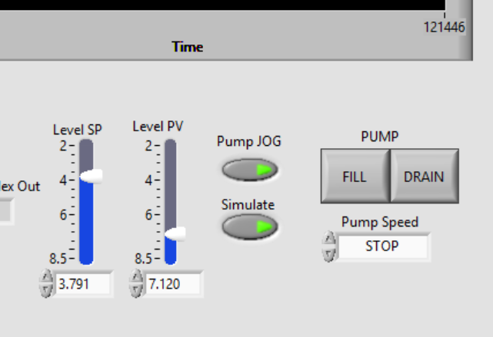
With Pump JOG button:
ON, the FILL and DRAIN buttons and the Pump Speed dropdown control the pump.
OFF then the Level (PV) goes to the SP.
Process Variable (PV) The measured Level.
Set Point (SP) The desired Level in automatic.
NOTE: SP, PV and Level indicate:
Tank is EMPTY when Level ~8.2”
Tank is FULL when Level ~ 2.4”
With Simulate ON, the Level PV and Green Plot should simulate the tank level.

Slide 19
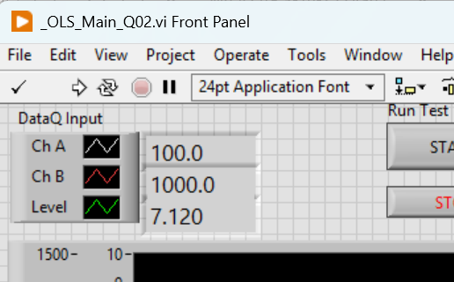
ChA Value.
ChB Value.
Level Value.

Slide 20
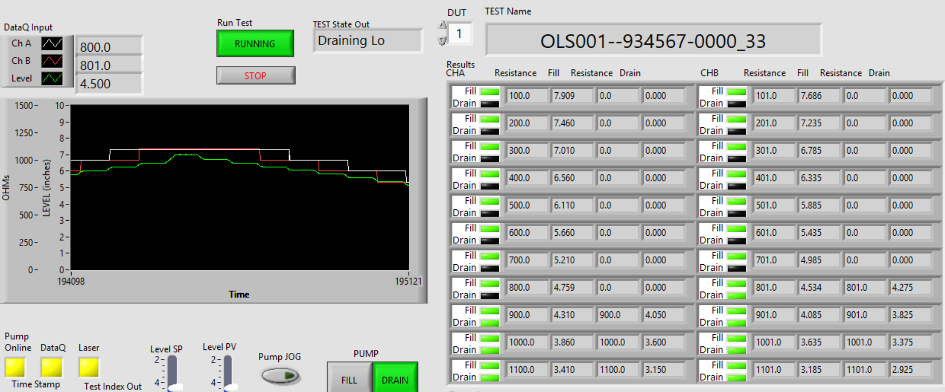
Measured Resistance
(4 places)
Measured Target Test Level
(4 places)
Current Test State
When Running (Green) The test protocol state machine sets the SP in automatic mode to create the stairstep level values.
FILL and DRAIN Status lights,
GREEN = PASS
RED = FAIL
YELLOW = Test Error
BLACK = Not Tested
ChA FILL
ChA DRAIN
ChB FILL
ChB DRAIN

Slide 21
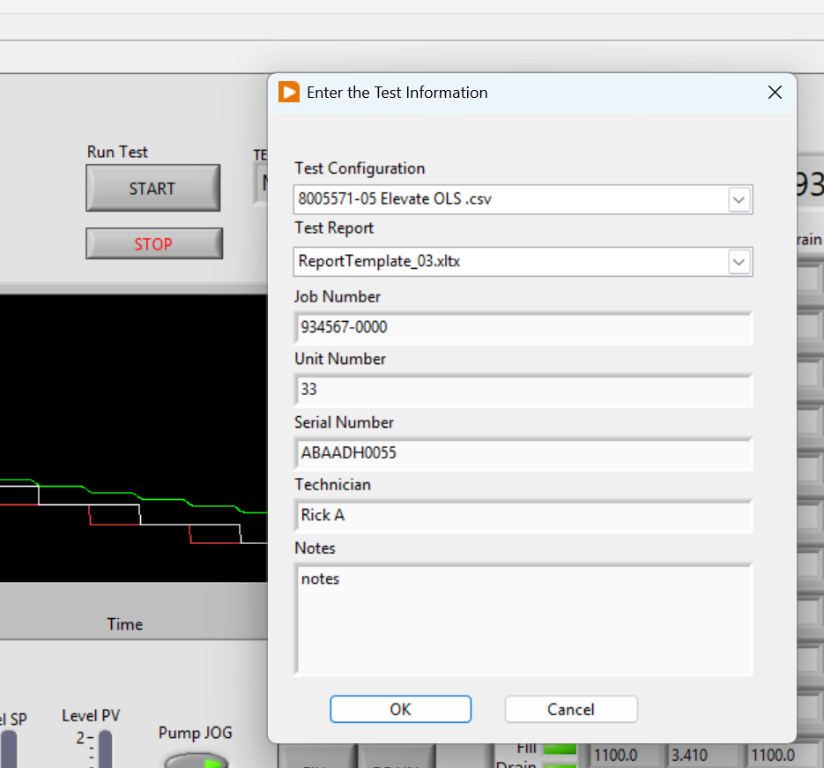
Test Information Dialog
STOP and Exit button.
Test Information Fields (7 Places)

Slide 22
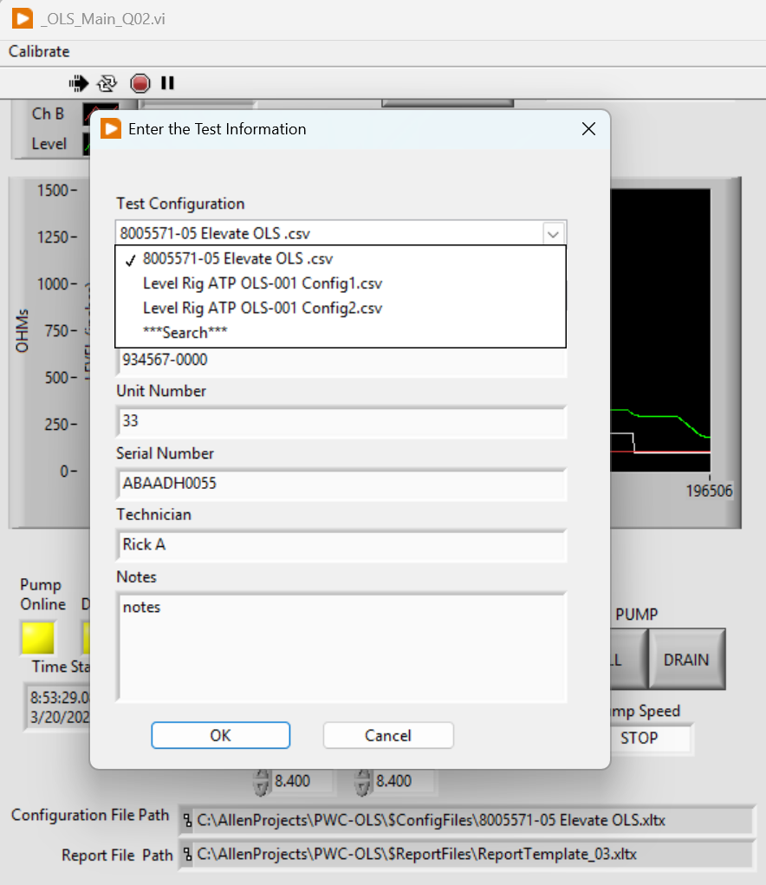
Config File Selection Field
Saved in Register
Currently Selected
Available Selection in current folder
Change Folder
Currently Selected
Full Path & Name

